Slide 1





Tech Days 2021 Flight into IoT
Clifford Agius
IoT Solutions Expert / Airline Pilot
CA Software Ltd
Azure MVP
@cliffordagius

Slide 2









Flight into IoT System Diagram
Service Bus Queue
Logic
App
3rd Party Services
IoT Hub
Time Series Insights
Device Provisioning Service
Stream Analytics
Power BI

Slide 3
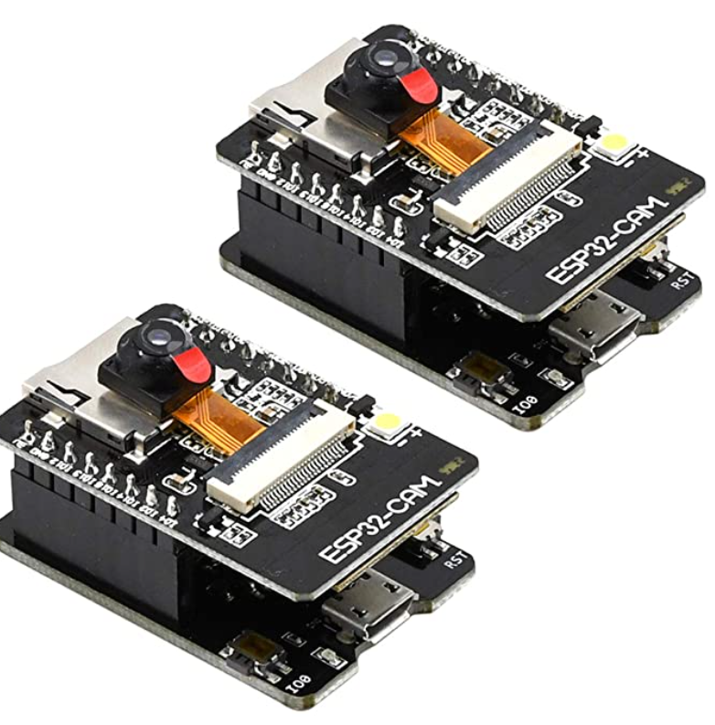
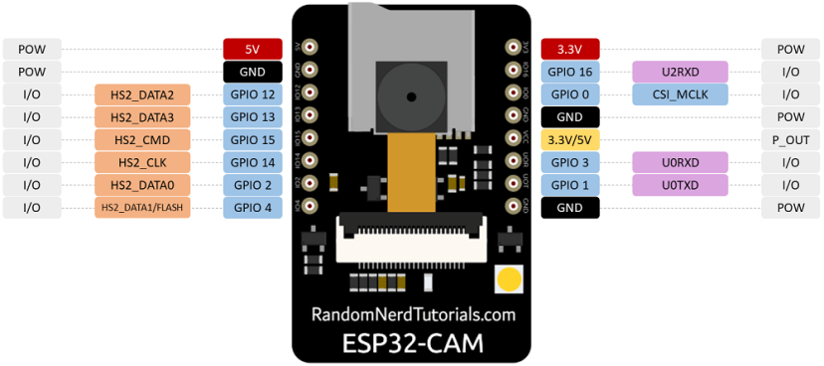
Flight into IoT System Device
FEATURES
Up to 160MHz clock speed，Summary computing power up to 600 DMIPS
Built-in 520 KB SRAM, external 4MPSRAM
Supports UART/SPI/I2C/PWM/ADC/DAC
Support OV2640 and OV7670 cameras, Built-in Flash lamp.
Support TF card
Supports multiple sleep modes.

Slide 4
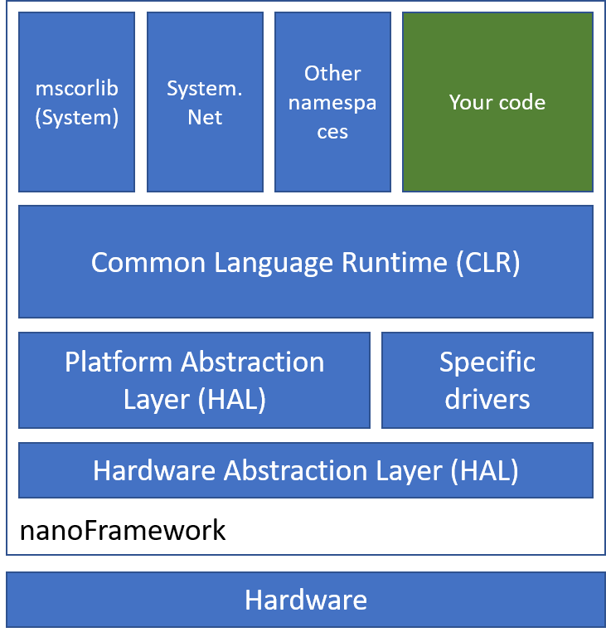
Flight into IoT System Device
The .NET nanoFramework platform picks up where .NET Micro Framework left off and uses some of its building blocks.
Many of the original components were completely rewritten
Uses a reduced version of the .NET Common Language Runtime (CLR) and features a subset of the .NET base class libraries.
Currently there are reference targets ready to use for ARM Cortex-M SoC and ESP32

Slide 5
Demos
IoT Hub Creation and Device Simulation

Slide 6
Flight into IoT Useful Links
Azure IoT Hub Docs
https://docs.microsoft.com/en-us/azure/iot-hub
nanoFrameWork
https://www.nanoframework.net
Install and use Azure IoT explorer
https://docs.microsoft.com/azure/iot-fundamentals/howto-use-iot-explorer
Derive the device key
https://docs.microsoft.com/azure/iot-dps/how-to-legacy-device-symm-key
Cloud Skills Challenge
https://docs.microsoft.com/learn/challenges
GitHub Repo
https://github.com/CliffAgius/TechDays2021

Slide 7
Thankyou
Q&A
Clifford Agius
IoT Solutions Expert / Airline Pilot
CA Software Ltd
Azure MVP
@cliffordagius

